Slide 1
Loan Repayment Assessment in Banking

Slide 2
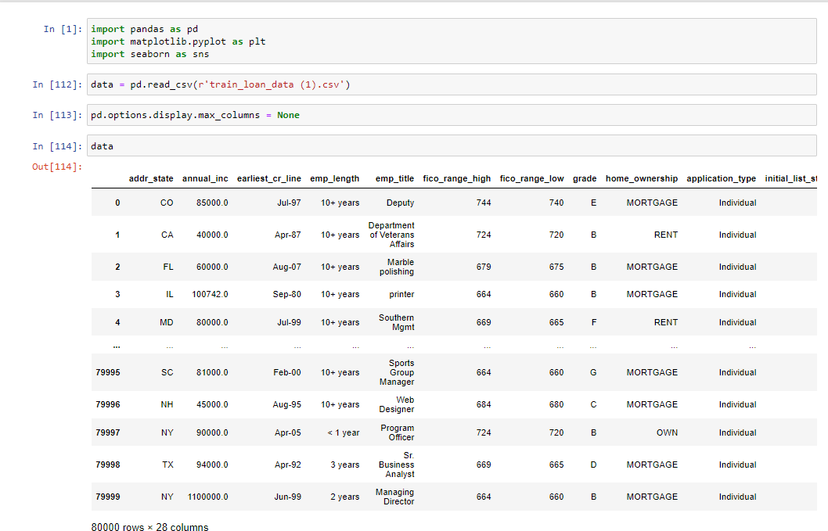
Loading the CSV Data file and Important modules
The dataset consist of 80 thousand rows and 23 features
Importing sum important labraries like pandas and matlab

Slide 3
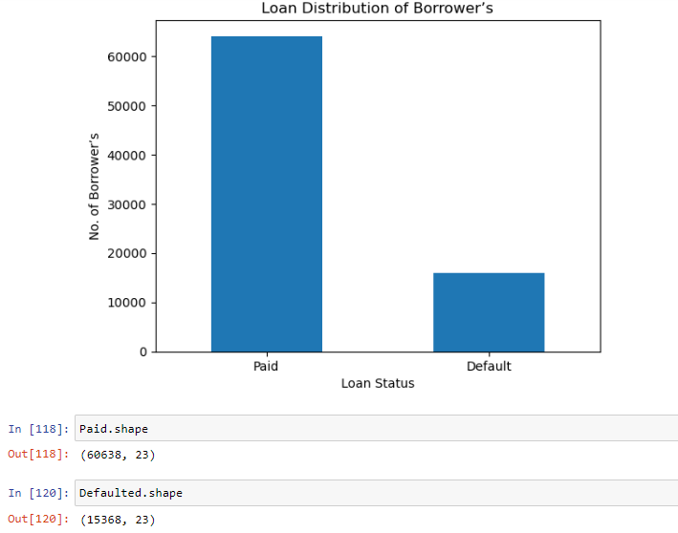
Exploratory Data Analysis:
Total 60,638 Borrower’s have paid there loan
Total number of Defaulted Borrower’s are 15368
75.70% of borrowers have paid the loan amount

Slide 4
Feature selection and Feature Engineering
There are some features which are not import and can effect our accuracy
addr_state , earliest_cr_line, emp_title, purpose, title are the features which are droped
Column emp_length contains str years and sign (+) which have been droped
Droping months from the columns term
Then encoding all the str categorical data to numeric
The features which missing values are less then 5% have been droped
Only emp_length feature has missing values more then 5% , so they have been filled with the mode of the column which is 10

Slide 5
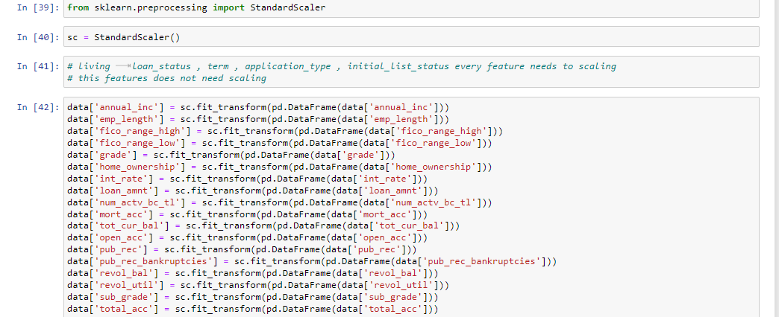
Feature Scaling
The feature which are outliers should be bring to the equal level
Columns annual_inc ,emp_length, fico_range_high, fico_range_low ,grade, home_ownership ,int_rate, loan_amnt, num_actv_bc_tl ,mort_acc ,tot_cur_bal ,open_acc ,pub_rec ,pub_rec_bankruptcies, revol_bal ,revol_util ,sub_grade ,total_acc
This are columns which have been scaled

Slide 6
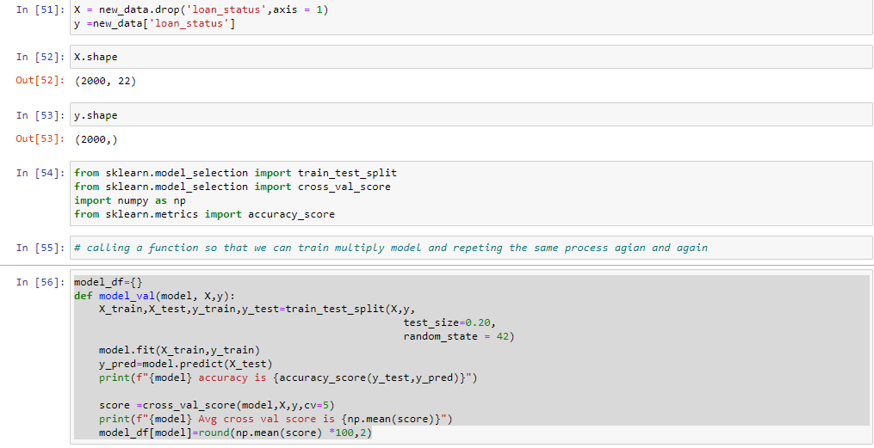
Spliting the data into train & test sets
Take the samples of both paid and defaulted status of 1000 random rows
Split the 80 present training data and 20 present test data and separate them in x which is independent and y which is dependent
A function is build so that we can train multiply method without repeating the same process

Slide 7
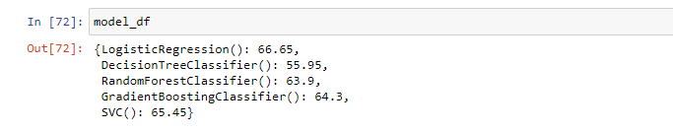
Traning Multiple Model
Training our model with multiple algorithms
We have used LogisticRegression , DecisionTree , RandomForestClassifier , GradientBoostingClassifier and SupportVectorClassifier
In this all LogisticRegression have given the best cross validation score of 66.65%

Slide 8
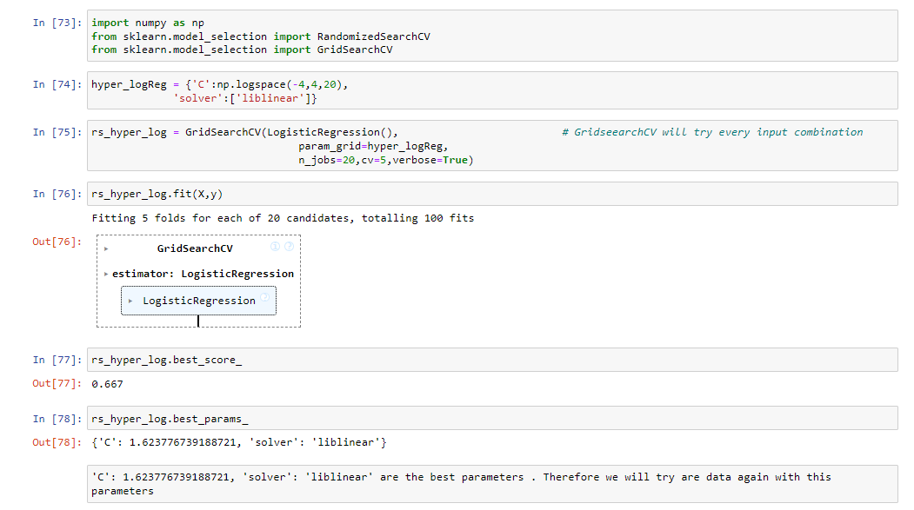
Hyperparameter Tuning
LogisticRegression have given the best cv score so we have done the hyperparameter tuning of LogisticRegression
Using GridsearchCV we got the score of 66.7% and the best params were solver value liblinear and C value of 1.62

Slide 9
Model Improvement
Input the best parameter obtain form hyperparameter tuning solve: liblinear and C :1.62
The model have been improved by CV score 66.7%

Slide 10
Testing the test data csv file
The feature selection , feature engineering and feature scaling which have been done on the train data the same engineering and scaling should be done on the test data file for accurate result
Then use the LogisticRegression model and the best parameter obtain by the hyperparameter tuning to test the test_file csv.

Slide 11
Thank you

